Slide 1

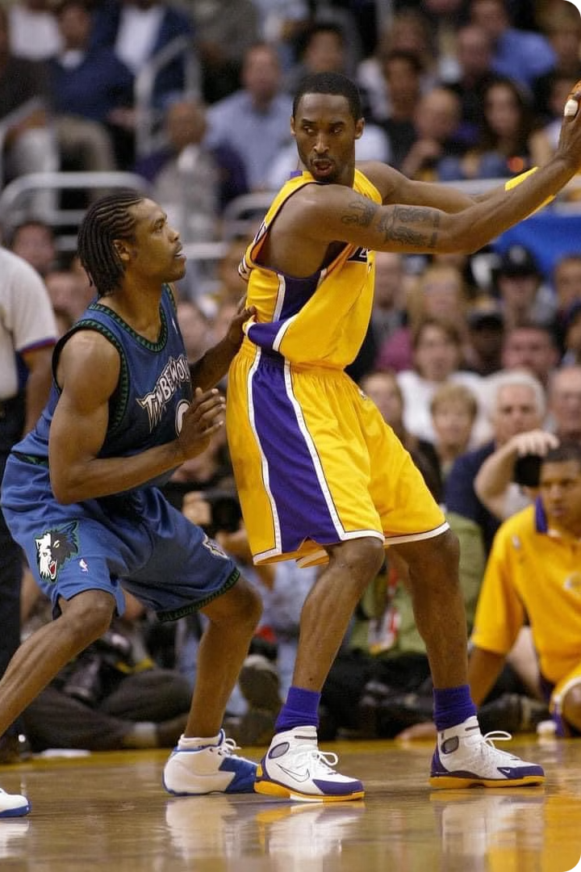
Using Machine Learning to Predict NBA Draft Outcomes
Explore how to apply machine learning techniques to forecast the future performance of NBA draft prospects.

Slide 2
NBA Draft Prediction Workflow
Data Extraction
1
📥 Connect to SQLite database.
📥 Extract data from relevant tables: player attributes, team salaries, player salaries, draft, draft combine, and game data.
Data Cleaning
2
🧼 Use mode (categorical) or mean (numeric) to fill missing values.
📥 Merge draft and draft combine data tables.
🧼 Remove irrelevant or redundant rows and columns.
📥 Delete unnecessary columns containing 'set' and 'location'.
🧼 Verify data integrity after cleaning.
Feature Engineering
3
🛠 Select relevant features based on domain knowledge.
🛠 Create new columns to capture position data.
4
Exploratory Data Analysis (EDA)
🛠 Calculate additional metrics (e.g., BMI).
🔍 Show summary statistics and distributions of key features.
🔍 Analyze the distribution of the target variable (whether drafted or not).
Data Transformation
5
🔄 Normalize or scale numeric features.
🔍 Visualize relationships and correlations between features.
🔄 Encode categorical features using one-hot encoding.
🔄 Split data into training, validation, and test sets.
Model Selection and Training
6
🧠 Select multiple models (e.g., logistic regression, decision trees, random forests, SVM, KNN, gradient boosting, XGBoost).
Model Evaluation and Interpretation
7
🧠 Train models using the training data.
🧠 Evaluate models using metrics like accuracy, precision, recall, F1-score, ROC-AUC, and specificity.
📊 Compare model performance based on evaluation metrics.
📊 Select the best model based on the required metric (e.g., recall).
8
Model Deployment
📊 Perform feature importance analysis to identify key predictive factors.
🚀 Save the best-performing model.
🚀 Load and use the model for real-time predictions.
SHAP Analysis for Model Interpretation
9
🔍 Generate SHAP values to explain model predictions.
10
Real-World Application
🏀 Collect actual data for new players (e.g., Kevin Durant, Bronny James).
🏀 Perform feature engineering and data standardization.
🏀 Use the saved model and SHAP analysis to predict draft position and explain the results.

Slide 3

Introduction
Project Overview
Importance of Prediction
Objective
The goal is to use data and machine learning to predict which players will be drafted and how they will perform in the NBA.
This project explores how to use machine learning to predict NBA draft outcomes and understand the resulting insights.
Accurately predicting draft results is crucial for teams to make wise decisions and build successful rosters.

Slide 4



Motivation
Building Successful NBA Rosters
Improving Recruitment Strategies
Personal Interest
As a data analysis enthusiast, I hope to deeply explore the patterns in the NBA draft.
Accurately predicting draft picks can help teams assess rookie potential and build long-term competitiveness.
Data analysis can help more effectively identify promising rookies and improve draft selection success rates.

Slide 5



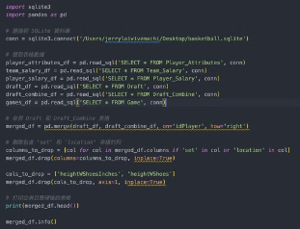
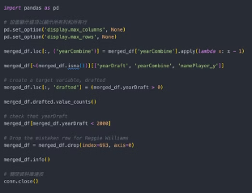
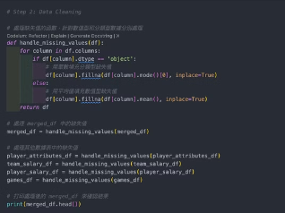
Exploring the Data Journey of the NBA Draft
Connect to SQLite Database
Integrate Draft Information
Clean and Preprocess
Extract player attributes, team salaries, player salaries, draft information, draft combine, and game data from the relevant tables.
Merge the draft and draft combine tables to consolidate the analysis-required information.
Clean and preprocess the extracted data to ensure it is in a format suitable for machine learning models.

Slide 6



Feature Engineering
Relevant Features
1
Select key attributes based on domain knowledge
Position Data
2
Create new columns to capture player position
Additional Indicators
3
Calculate metrics like BMI to enrich the dataset
As an NBA expert (a basketball fan, that is), I believe these are useful features. The remaining columns are mostly organization names, which have high cardinality and are difficult to use as features.
feature_list = ['idPlayer', 'namePlayer_y', 'yearDraft', 'yearCombine', 'numberPickOverall', 'slugPosition', 'heightWOShoesInches','weightLBS', 'wingspanInches', 'reachStandingInches', 'verticalLeapStandingInches', 'verticalLeapMaxInches', 'repsBenchPress135','timeLaneAgility', 'timeThreeQuarterCourtSprint', 'timeModifiedLaneAgility', 'lengthHandInches', 'widthHandInches', 'pctBodyFat', 'drafted']

Slide 7
Key Observations (Statistical Descriptions)
Feature
Description
Number of Players
1,366 unique players
Player Positions
14 unique positions, with Power Forward (PF) being the most common
Players Drafted
808 players drafted, 586 players undrafted
Draft Years
2000-2020
Combine Years
2000-2020
Height (Without Shoes)
Average 197.1 cm
Weight
Average 98 kg
Wingspan
Average 209.3 cm
Standing Reach
Average 262.7 cm
Standing Vertical Leap
Average 74.2 cm
Max Vertical Leap
Average 87.4 cm
Bench Press (135 lbs)
Average 10.3 reps
Lane Agility
Average 11.4 seconds
3/4 Court Sprint
Average 3.29 seconds
Hand Length
Average 22.1 cm
Hand Width
Average 23.9 cm
Body Fat Percentage
Average 7.6%

Slide 8
Exploring NBA Player Data
1
Missing Values
2
Most Common Categories
3
Summary
The dataset provides a comprehensive understanding of NBA players' physical attributes and performance, which can aid in scouting, training, and draft decision-making. Addressing the missing data for secondary positions will further improve the utility and reliability of the analysis.
Only 496 records have data for secondary position, indicating significant missing data
Most common player name: Josh Hart (2 times)
Most common primary position: Power Forward (PF), 376 times
Most common secondary position: Small Forward (SF), 143 times

Slide 9
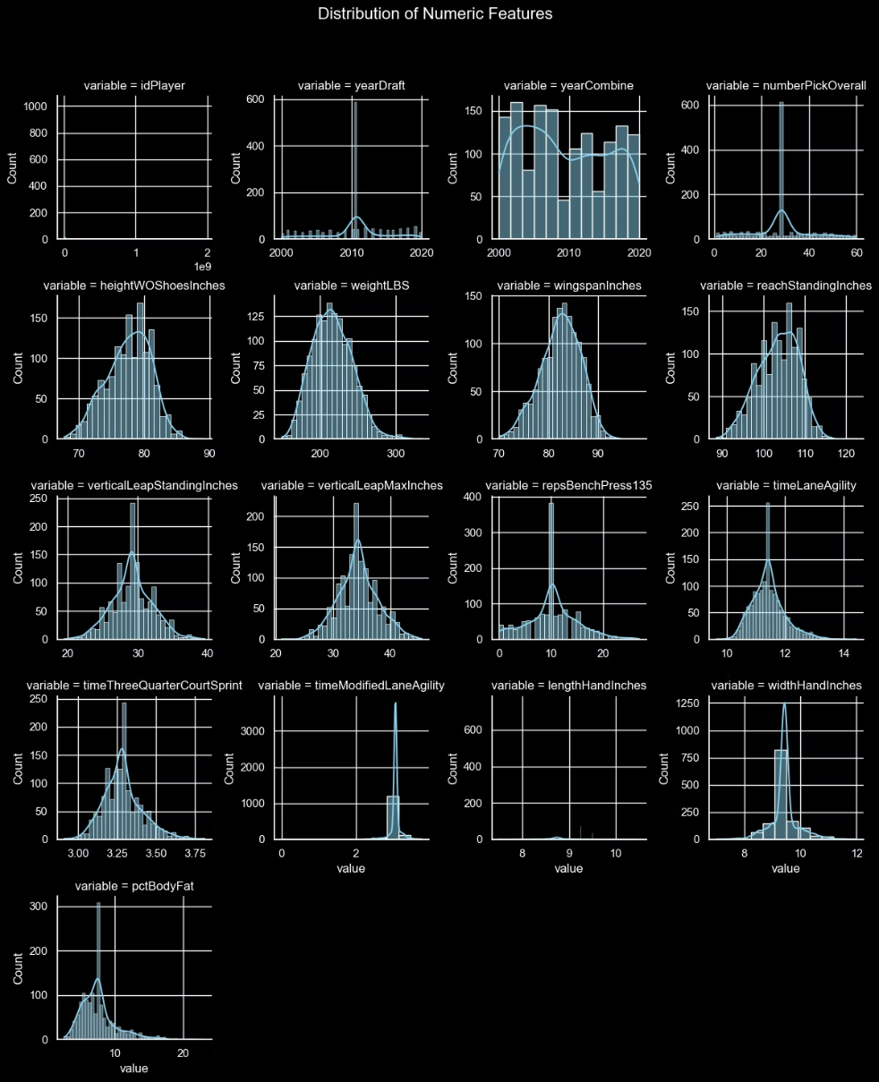
Distribution of Numerical Features
Overview
Histogram analysis of the numerical features in the NBA draft dataset reveals the distribution and trend patterns of various physical and performance indicators for the players. This analysis helps to understand the basic patterns in the data and identify any anomalies or trends.
Key Observations
Feature
Distribution
Implications
idPlayer
Highly skewed, with most values concentrated in a specific range
The idPlayer is a unique identifier and does not provide useful information for the analysis
yearDraft
Data shows a large number of players were selected around 2010 and 2015
This indicates the dataset includes players from different draft years, with some years having higher peaks
yearCombine
Similar to yearDraft, with noticeable peaks around 2004 and 2015
The patterns in the combine data match the draft data, reflecting the years when players participated in the combine
numberPickOverall
Higher frequency of lower pick numbers, indicating more players were selected early in the draft
This suggests the dataset includes more high-performing players, which may bias the analysis towards high-performing players
heightWOShoesInches
Roughly normally distributed, centered around 77.6 inches (197.1 cm)
Indicates the typical height of NBA players, with most players within a few inches of the average
weightLBS
Roughly normally distributed, centered around 216.1 lbs (98 kg)
Reflects the average weight of NBA players, providing insights into their typical body types
wingspanInches
Normally distributed, with an average of 82.4 inches (209.3 cm)
Indicates the standard wingspan range of NBA players, which is crucial for evaluating player reach
reachStandingInches
Normally distributed, with an average of 103.4 inches (262.7 cm)
Suggests the typical standing reach of players, which is essential for assessing defensive and offensive capabilities
verticalLeapStandingInches
Roughly normally distributed, centered around 29.2 inches (74.2 cm)
Provides insights into player explosiveness, which is crucial for rebounding and shot blocking abilities
verticalLeapMaxInches
Normally distributed, with an average of 34.4 inches (87.4 cm)
Reflects the maximum vertical leap height, highlighting the players' athleticism
repsBenchPress135
Skewed distribution, with most values concentrated around 10.3 reps
Indicates the upper body strength of players, which is crucial for physical battles in NBA games
timeLaneAgility
Roughly normally distributed, centered around 11.4 seconds
Reflects the agility of players, which is essential for quick movements on the court
timeThreeQuarterCourtSprint
Normally distributed, with an average of 3.29 seconds
Highlights the sprint speed of players, which is crucial for fast breaks and defensive rotations
timeModifiedLaneAgility
Some outliers, with most values concentrated at a specific point
May indicate issues with data collection or specific situations affecting the recorded times
lengthHandInches
Normally distributed, centered around 8.7 inches (22.1 cm)
Reflects the typical hand length, which is related to ball handling and shooting
widthHandInches
Normally distributed, centered around 9.4 inches (23.9 cm)
Suggests the hand width, which affects grip and ball control
pctBodyFat
Skewed distribution, with most values concentrated around 7.6%
Displays the body fat percentage of players, which is important for evaluating physical fitness and condition
Summary
The histograms show that most physical and performance indicators follow a roughly normal distribution, with a few features exhibiting skewness or anomalies. These insights help to understand the typical player profiles in the NBA and identify any outliers or trends in the data. This information is crucial for scouting, training, and predictive modeling in basketball analysis.

Slide 10
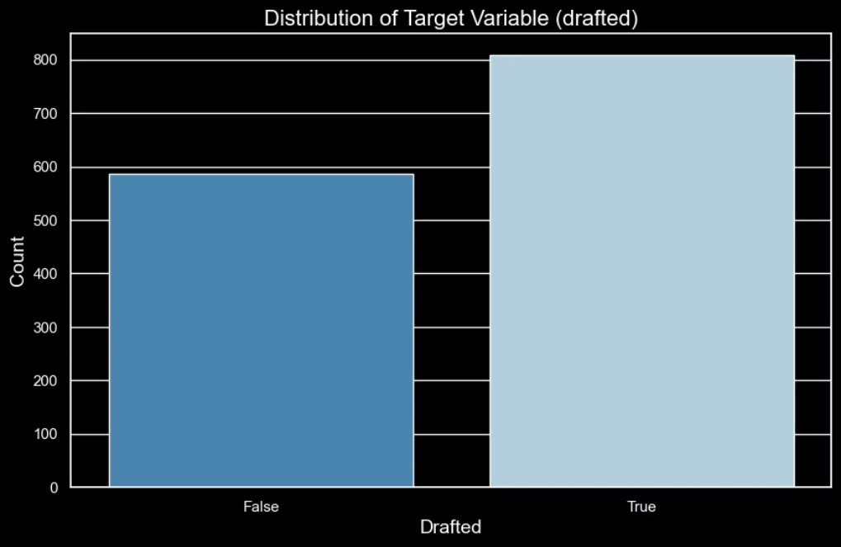
Distribution of the Target Variable
The distribution of the target variable drafted shows that players who were drafted are slightly more than those who were not. This is helpful for training machine learning models, as it allows the model to learn better and make more accurate predictions. However, to ensure the model performs fairly, we should still try to balance the distribution of the target variable as much as possible.

Slide 11
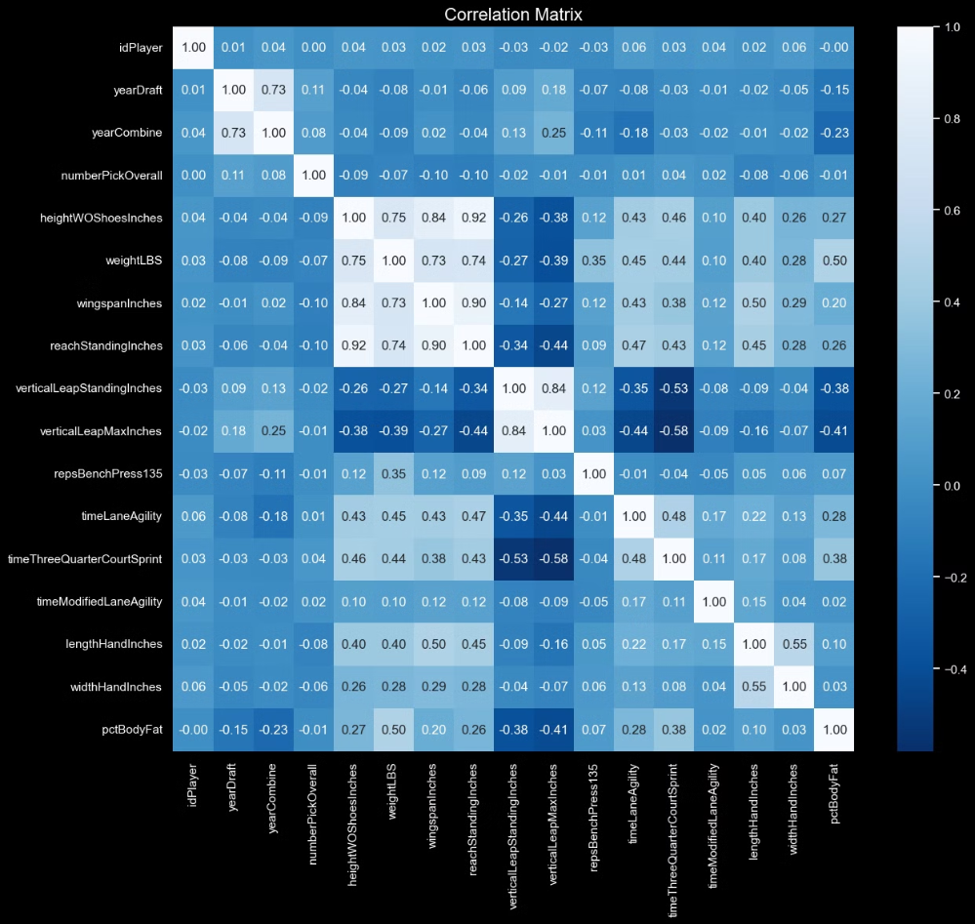
Correlation Matrix Heatmap
Correlation analysis reveals the important relationships between numerical features in the NBA draft dataset. Strong positive correlations show that height is closely related to standing reach (0.920), wingspan (0.836), and vertical jump (0.839), highlighting the significance of these features for defensive and offensive capabilities. Moderate positive correlations, such as weight with height (0.755) and agility with sprint time (0.485), emphasize the critical nature of body size and athletic ability. Weak negative correlations, like maximum vertical jump with sprint time (-0.580) and body fat with vertical jump (-0.415), indicate the impact of explosiveness and body composition on performance. These insights are crucial for scouting, training, predictive modeling, and player positioning, improving overall team performance and player abilities.

Slide 12



Data Transformation
Numerical Feature Normalization
Categorical Feature Encoding
Data Split
Split the dataset into training, validation, and test sets to properly evaluate model performance.
Normalize or scale numerical features to ensure they are all on a similar magnitude.
Use one-hot encoding to transform categorical features into a format that machine learning models can handle.

Slide 13
Model Selection and Training
Model Selection
1
We selected multiple models (such as logistic regression, decision trees, random forests, support vector machines, K-nearest neighbors, gradient boosting, and XGBoost)
2
Model Training
We trained the models using the training data
Model Evaluation
3
We evaluated the models using metrics like accuracy, precision, recall, F1-score, ROC-AUC, and specificity
Accuracy
Precision
Recall
F1 Score
ROC-AUC
Specificity
Logistic Regression
0.637232
0.635841
0.637232
0.636406
0.656439
0.561111
Decision Tree
0.568019
0.560783
0.568019
0.562054
0.550023
0.422222
Random Forest
0.632458
0.626726
0.632458
0.622360
0.661820
0.450000
Support Vector Machine
0.637232
0.634110
0.637232
0.618519
0.663680
0.394444
K-Nearest Neighbors
0.551313
0.537663
0.551313
0.537271
0.589319
0.344444
Gradient Boosting
0.649165
0.644636
0.649165
0.641673
0.676034
0.488889
XGBoost
0.627685
0.621597
0.627685
0.618134
0.657020
0.450000

Slide 14



Model Evaluation and Interpretation
Compare Models
1
Evaluate model performance using key metrics
Select Best Model
2
Choose the model with the highest recall (sensitivity)
Analyze Feature Importance
3
Conduct feature importance analysis
The model evaluation process includes comparing the performance of various models based on key metrics such as accuracy, precision, recall, and F1 score. The model with the highest recall was selected as the best model(Gradient Boosting). Additionally, feature importance analysis was performed to understand which attributes are most important for the model's predictions.

Slide 15
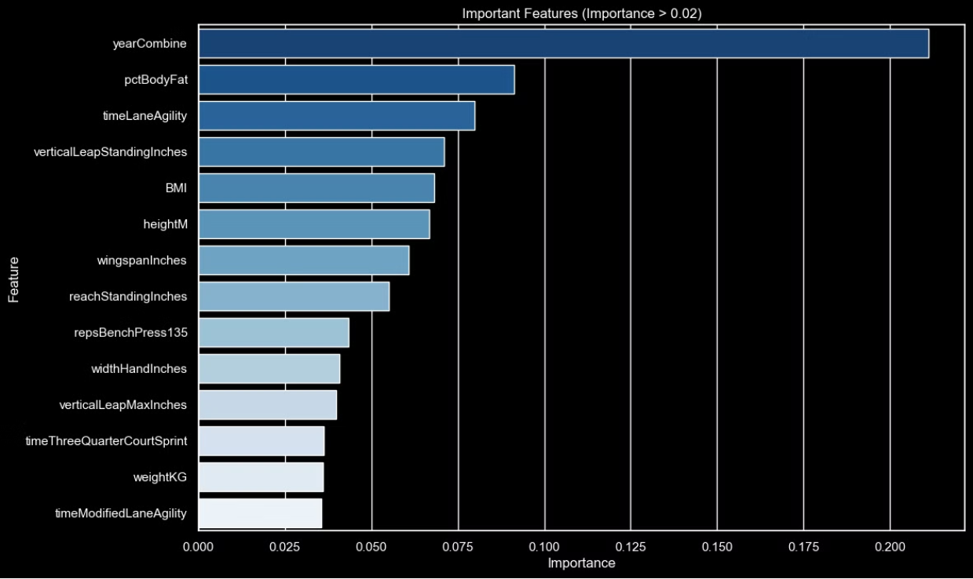
Analyzing Feature Importance
Feature Importance Analysis
Key Attributes Impacting NBA Draft Predictions
🏀 Year of NBA Combine Participation: 0.2126
Insight: Recent performance data is highly valuable.
🏋️ Body Fat Percentage: 0.0905
Insight: Indicates the player's physical condition.
🏃‍♂️ Lateral Quickness: 0.0815
Insight: Reflects the player's ability to move quickly.
🦘 Vertical Jump: 0.0691
Insight: Indicates the player's explosiveness.
📊 BMI (Body Mass Index): 0.0690
Insight: Reflects the player's body composition.
⛹️ Height: 0.0680
Insight: Crucial for both offense and defense.
👐 Wingspan: 0.0593
Insight: Important for reach in both offense and defense.
📏 Standing Reach: 0.0535
Insight: Key for defensive and offensive actions.
💪 Bench Press Reps: 0.0434
Insight: Shows the player's upper body strength.
✋ Hand Width: 0.0412
Insight: Indicates ball-handling skills.
🏃‍♂️ Maximum Vertical Jump: 0.0390
Insight: Reflects the player's peak explosiveness.
🏃 3/4 Court Sprint: 0.0363
Insight: Measures speed over a short distance.
⚖️ Weight: 0.0360
Insight: An indicator of the player's physical build.
🏃‍♂️ Modified Lane Agility: 0.0355
Insight: Indicates the player's agility and endurance.
Application in NBA Teams
These attributes collectively provide NBA teams with a comprehensive evaluation of a player's readiness and potential impact on the court.

Slide 16
Model Optimization
{'Accuracy': 0.6539379474940334, 'Precision': 0.6497070343443696, 'Recall': 0.6539379474940334, 'F1 Score': 0.646548411226029, 'ROC-AUC': 0.6652022315202233, 'Specificity': 0.49444444444444446}
This process focuses on improving the model by emphasizing the key features for predicting NBA draft outcomes. Initially, a gradient boosting model was used to identify feature importance, then features with importance scores greater than 0.02 were selected to retrain the model, in order to improve the recall.
The main recall metric increased from 0.6420 to 0.6516, enhancing the model's ability to correctly identify all selected players while minimizing false positives. This ensures comprehensive identification of potential draftees, which is critical for effective scouting and decision-making.

Slide 17



Key Challenges
Missing Data
Model Generalization
Balancing Metrics
Addressing missing data in the dataset is a critical challenge, requiring careful imputation techniques to ensure model reliability.
Ensuring the model can generalize well to unseen data is crucial for its practical viability.
Balancing different performance metrics, such as accuracy and recall, is necessary to optimize the model for project goals.

Slide 18

Implemented Solutions
Techniques for Handling Missing Values
Cross-Validation
Applying cross-validation to avoid overfitting and ensure the model can generalize well to unseen data.
Using imputation techniques to address missing values in the dataset, ensuring the machine learning model is trained on complete and reliable data.
Focusing on Recall
Prioritizing recall as a key performance metric to minimize false negatives and accurately identify selected players.

Slide 19

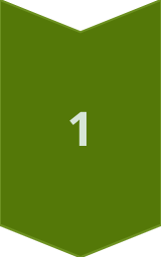
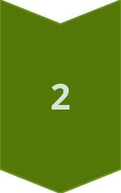
SHAP Analysis
Explain Predictions
Use SHAP values to understand how each feature impacts the model's predictions.
Insights and Interpretability
SHAP analysis provides valuable insights and improves the interpretability of the model's decision process.

Slide 20
Practical Application
Data Collection
1
Collect real data on new players
Feature Engineering
2
Apply feature engineering and standardization
Predict Draft Position
3
Use the saved model to predict draft position

Slide 21

Kevin Durant
Apply
Height (without shoes): 81.75 inches (6'9.75")
Weight: 240 lbs
Wingspan: 87.5 inches
Standing Reach: 96.0 inches
Vertical (No-Step): 33.5 inches
Vertical (Max): 39.0 inches
Bench Press Reps: 3
Lane Agility Time: 11.18 seconds
3/4 Court Sprint: 3.45 seconds
Body Fat %: 6.9%
Combine Participation: 2007
The analysis for Kevin Durant shows that he has impressive athletic qualities, and the model predicts he will be selected with a 0.90 probability.
Kevin Durant was selected in the 2007 NBA Draft. He was chosen 2nd overall by the Seattle SuperSonics, who later became the Oklahoma City Thunder.

Slide 22

Bronny James Analysis
Height (without shoes)
74.75 inches (6'2.75")
Weight
180 pounds
Wingspan
80.0 inches
Standing Reach
95.0 inches
Vertical (Standing)
31.5 inches
Vertical (Max)
35.5 inches
Bench Press Reps
10
Lane Agility Time
11.00 seconds
3/4 Court Sprint
3.25 seconds
Body Fat %
7.2%
Participated in Combine
2024
My Bronny James' draft analysis: Drafted (Probability: 0.68), there is a lot of disagreement about whether Bronny James will be drafted in the 2024 NBA Draft.
Many mock drafts, including Sports Illustrated and The Ringer, project him to be selected in the second round, often by the Los Angeles Lakers, partly due to the pairing with his father LeBron James.
Other teams like the Utah Jazz and Miami Heat have also expressed interest, with the Jazz holding the 32nd pick and the Heat having the 15th and 43rd picks. Despite these interests, concerns remain about Bronny's performance at USC and the incident of cardiac arrest, and he was not included in ESPN's latest mock draft.
Betting odds show the Lakers as the most likely to select him, but there is uncertainty around his draft position, reflecting the differing opinions of analysts. Overall, Bronny's draft status is a much-discussed topic.

Slide 23

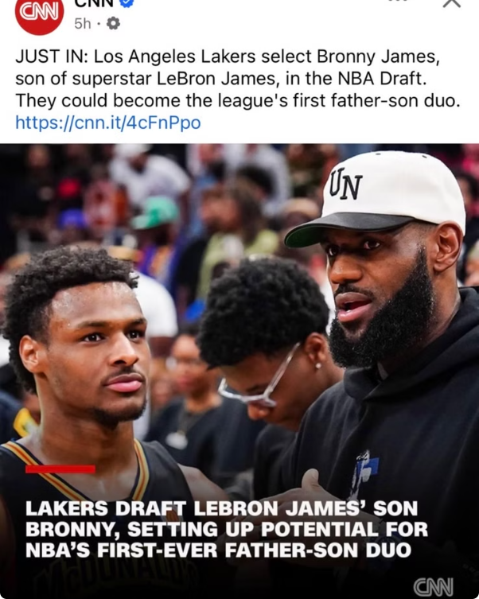
Bronny James' NBA DRAFT OUTCOME
NBA Draft 1st Round Outcome
NBA Draft 2nd Round Outcome
Just as predicted, Bronny James wasn't selected in the first round of the 2024 NBA Draft.
But what really blew my mind was that my analysis was spot-on: Bronny James got chosen by the Los Angeles Lakers in the second round
This shows my analysis had value... YAAAAAAAAS! PS: Wrapped up this project on June 13, 2024.

Slide 24
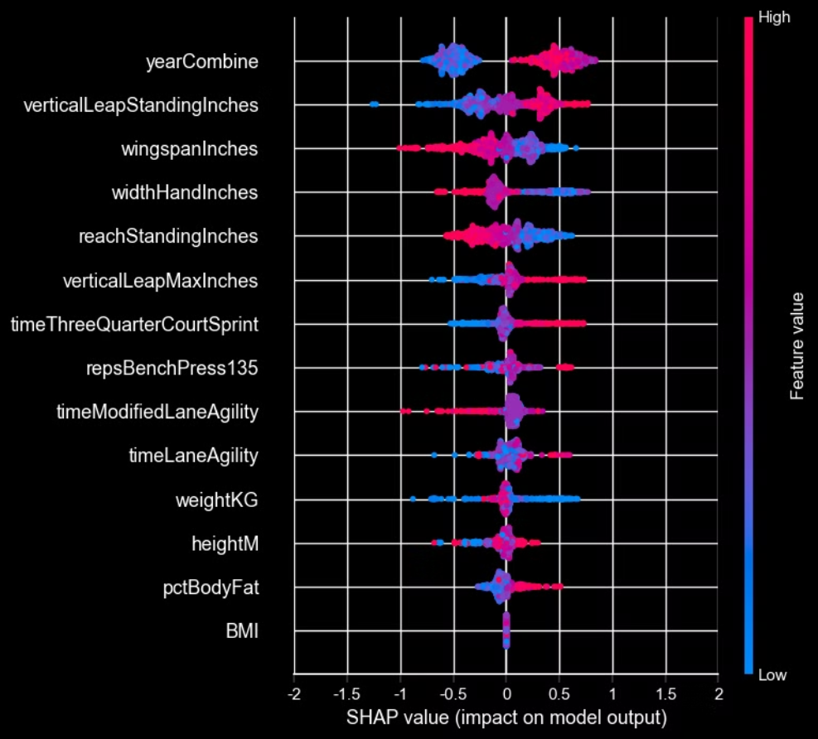
SHAP Analysis: Key Insights
Top Features
Positive Impacts
Negative Impacts
Mixed Impact
yearCombine, verticalLeapStandingInches, and wingspanInches have the widest spread in SHAP values, indicating significant impact on the model's predictions.
yearCombine, verticalLeapStandingInches, and wingspanInches positively influence the predictions, suggesting more recent combines and higher physical attributes lead to better performance metrics.
timeThreeQuarterCourtSprint and timeModifiedLaneAgility negatively impact the predictions, indicating that faster sprint times and better agility are crucial for higher performance.
weightKG shows both positive and negative impacts depending on other factors, suggesting weight is a complex factor in predicting performance.

Slide 25




Reflection on the Model's Improvement
Interaction Features
Feature Engineering
Leveraging Recent Data
Excluding Superstars
Create interaction terms between the most impactful features, like verticalLeapStandingInches * wingspanInches, to capture combined athleticism metrics.
Implementing more relevant features like Points Per Game, Assists Per Game, and Shooting Percentages can significantly improve the model's prediction accuracy.
Filtering out exceptionally talented players (outliers) and focusing the model on predicting the performance of more average players can provide greater insight into the true value of the model.
Focusing the model on data from the last five years can better capture the evolving playing styles in the NBA and further improve the model's accuracy.

Slide 26

Final Thoughts
This project demonstrates the powerful potential of data analysis and mahicne learning in the sports domain, and its ability to transform the NBA draft process.
This work emphasizes the importance of continuous learning and adaptation to remain at the forefront of rapidly evolving fields.

Slide 27

Thank you!
I appreciate your time reading my work.

